Slide 1

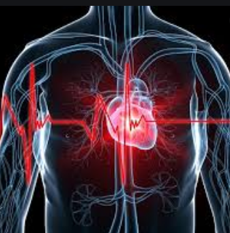
Cardiovascular system
Dr P. Mary Anupama
Assistant Professor
Dept. of Biochemistry
St. Joseph’s college for Women (A)
Visakhapatnam

Slide 2
Topics covered
Blood components and their function
Genesis of Erythrocytes.
Resistance of the body to infection
Blood groups: the ABO system, the rhesus system
Blood clotting factors, intrinsic and extrinsic pathways for blood clotting

Slide 3
BLOOD COMPONENTS AND THEIR FUNCTION
Blood performs many important functions within the body, including:
Supply of oxygen
Supply of nutrients such as glucose, aminoacids and fatty acids
Removal of waste such as carbon dioxide, urea, lactic acid
Immunological functions
Coagulation
Messenger functions- via hormones
Regulation of body temperature
Hydraulic function

Slide 4
Important point about Blood
Volume of blood in adult- 5 liters
Major cell components of blood are Erythrocytes, Leukocytes and platelets.
Volume of RBC- 45% of whole blood
Plasma- 54.3%
WBC- 0.7%

Slide 5
Blood plasma composition
It is straw yellow in color
Volume- 2.7 to 3 liters
It has 92% water, 8% plasma proteins and others with nutrients n traces
pH- 7.35 to 7.45
Other important components include:
Serum albumin
Blood-clotting factors
Immunoglobulin's
Lipoprotein particles
Various other proteins and electrolytes ( mainly sodium and Chloride ions)

Slide 6
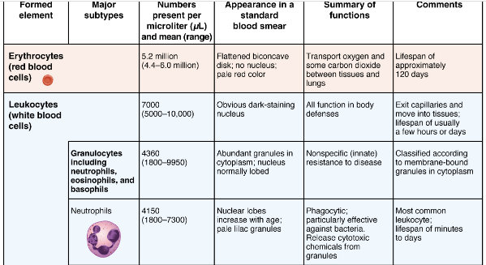

Slide 7
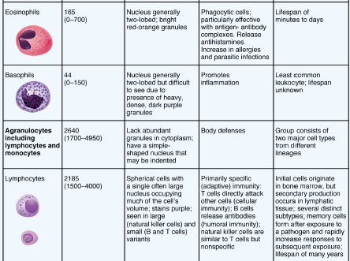

Slide 8
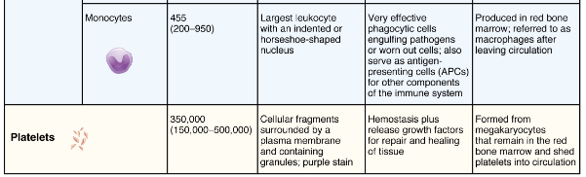
BLOOD COMPONENTS AND THEIR FUNCTIONS

Slide 9
ERYTHROPOIESIS
Derived from the Greek word- erythro – Red, poiesis- to make
It is stimulated by decrease in oxygen content, by kidney which produces- erythropoietin that stimulates proliferation of RBC in Bone marrow

Slide 10
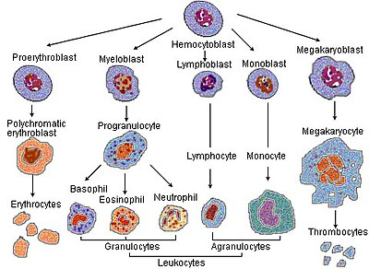
HEMOPOIESIS- INCLUDING ERYTHROPOIESIS

Slide 11
ABNORMALITIES ASSOCIATED WITH ERYTHROPOIESIS
Anemia: a condition with an abnormally low level of functional haemoglobin
Polycythemia: a condition with an abnormally high level of red blood cells
Dyserythropoiesis: a problem with the development of red blood cells

Slide 12
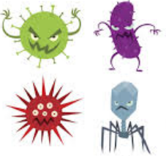
Defense again infections
Natural barriers - skin, mucous membranes, tears, earwax, mucus, and stomach acid. Also, the normal flow of urine washes out microorganisms that enter the urinary tract.
The immune system uses white blood cells and antibodies to identify and eliminate organisms that get through the body’s natural barriers.
The body also defends by increasing the number neutrophils and monocytes
The number of eosinophils, increases in allergic reactions and many parasitic infections, but usually not in bacterial infections.

Slide 13
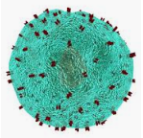
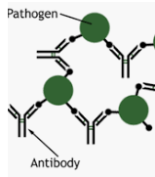
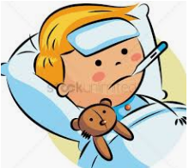
Defense again infections
Immune system also responds by producing several substances and agents that are designed to attack the specific invading microorganisms Examples are
Killer T cells (that can recognize and kill the invading microorganism
Antibodies that target the specific invading microorganism
Inflammation and fever- A swelling associated with redness and heat helps to combat infections. During fever physiological reactions increase leading to increase in body temperature and offering protection.

Slide 14
Blood groups
It is classification of Blood types based on presence or absence of antibodies and inherited antigens.
Blood types are inherited and represent contributions from both parents. A total of 36 human blood group systems and 346 antigens are now recognized by the International Society of Blood Transfusion (ISBT)
Major classes of blood groups
ABO system
Rh system

Slide 15
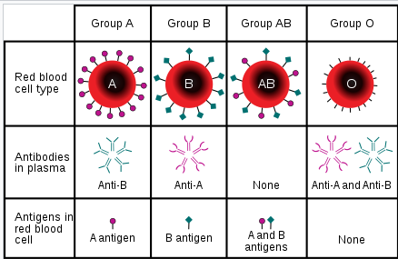
ABO BLOOD GROUP SYSTEM

Slide 16
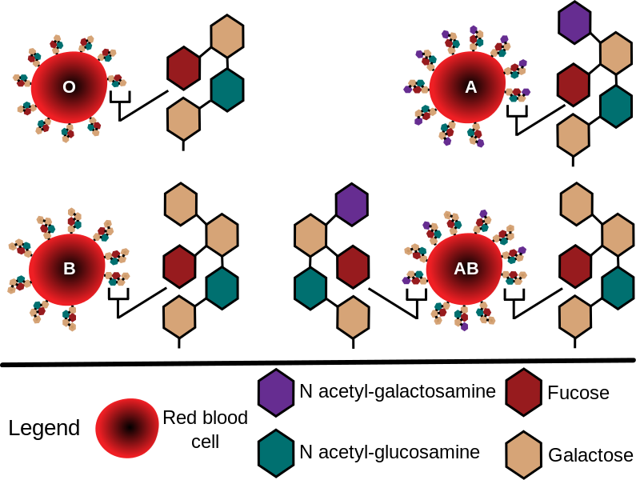
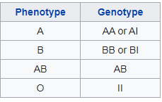
SURFACE ANTIGENS ON RBC
PHENOTYPE AND GENOTYPE

Slide 17
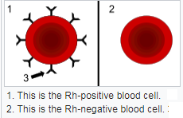
Rh SYSTEM
The term "Rh" was originally an abbreviation of "Rhesus factor." It was discovered in 1937 by Karl Landsteiner and Alexander S. Wiener
he main antigens are D, C, E, c and e, which are encoded by two adjacent gene loci, the RHD gene which encodes the RhD protein with the D antigen (and variants

Slide 18
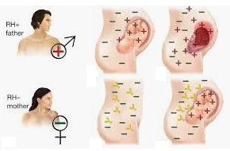
ERYTHROBLASTOSIS FOETALIS

Slide 19
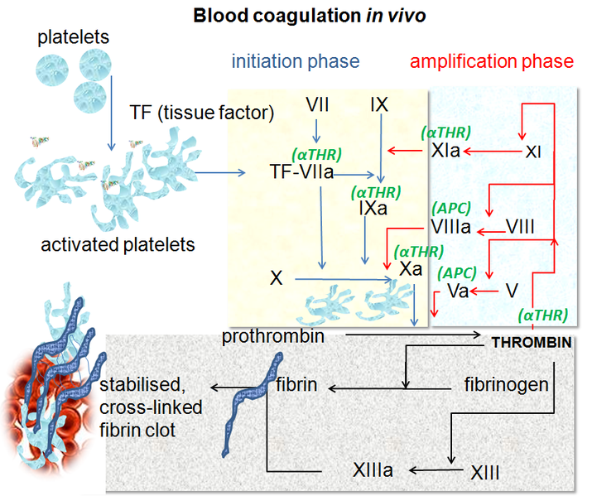

Slide 20
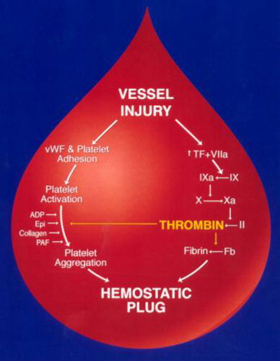
Blood coagulation
Coagulation, also known as clotting,
It is the process by which blood changes from a liquid to a gel, forming a blood clot.
It potentially results in hemostasis, the cessation of blood loss from a damaged vessel, followed by repair.
The mechanism of coagulation involves activation, adhesion and aggregation of platelets, as well as deposition and maturation of fibrin.

Slide 21
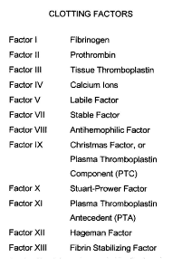

Slide 22
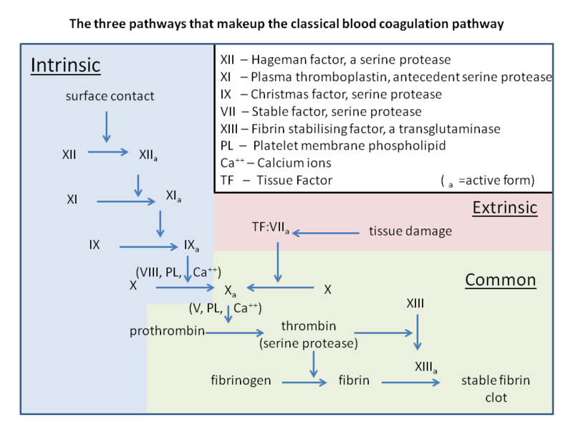
CLASSIC BLOOD COAGULATION PATHWAY

Slide 23
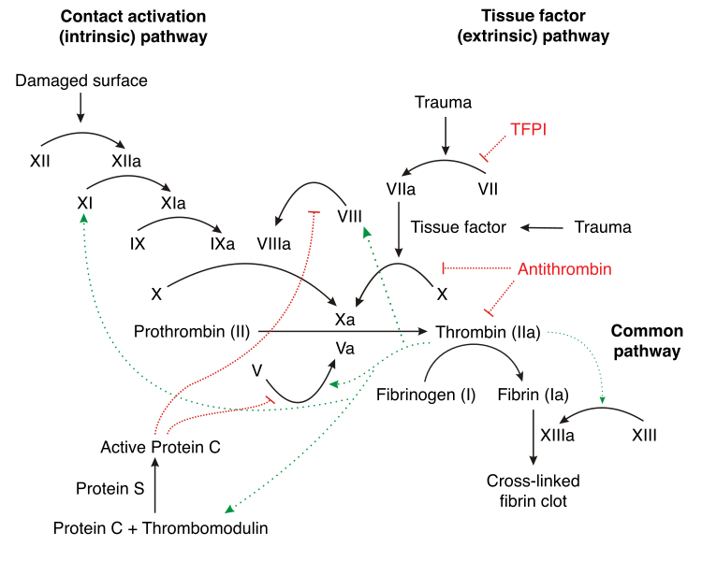
Coagulation pathways with arrows

Slide 24
DISORDERS ASSOCIATED
The best-known coagulation factor disorders are the hemophilias.
The three main forms are hemophilia A (factor VIII deficiency), hemophilia B (factor IX deficiency or "Christmas disease") and hemophilia C (factor XI deficiency, mild bleeding tendency).
Hemophilia A and B are X-linked recessive disorders, whereas Hemophilia C is a much more rare autosomal recessive disorders.
In liver failure (acute and chronic forms), there is insufficient production of coagulation factors by the liver; this may increase bleeding risk.
Deficiency of Vitamin K may also contribute to bleeding disorders because clotting factor maturation depends on Vitamin K.

Slide 25
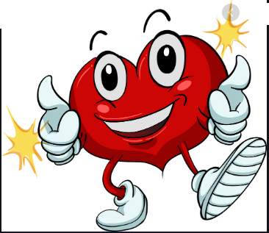
Thank you

